Slide 1
End-to-End PJ
Weather Data Pipeline

Slide 2











Architecture Diagram for Project
%3CmxGraphModel%3E%3Croot%3E%3CmxCell%20id%3D%220%22%2F%3E%3CmxCell%20id%3D%221%22%20parent%3D%220%22%2F%3E%3CmxCell%20id%3D%222%22%20value%3D%22Amazon%20S3%22%20style%3D%22sketch%3D0%3BoutlineConnect%3D0%3BfontColor%3D%23232F3E%3BgradientColor%3Dnone%3BstrokeColor%3D%23ffffff%3BfillColor%3D%23232F3E%3Bdashed%3D0%3BverticalLabelPosition%3Dmiddle%3BverticalAlign%3Dbottom%3Bg%3D3%3Bshape%3Dmxgraph.aws4.productIcon%3BprIcon%3Dmxgraph.aws4.s3%3B%22%20vertex%3D%221%22%20parent%3D%221%22%3E%3CmxGeometry%20x%3D%22380%22%20y%3D%22230%22%20width%3D%2280%22%20height%3D%22100%22%20as%3D%22geometry%22%2F%3E%3C%2FmxCell%3E%3C%2Froot%3E%3C%2FmxGraphModel%3E
Lambda
Snow Pipe

Slide 3
Project Overview
Description: Using Apache Airflow Hosted on AWS Ec2 the source Json data is generated for every 5min and moved to S3 Bucket by Airflow DAG’s. Leveraging the Lambda Function the source data is moved for Source-ETL S3 path. As soon as the file lands to Source-ETL S3 path a Glue Job will be triggered (by another Lambda Function).
Once the Transformation are completed by Glue the .csv is stored into a final S3 path which will picked by snowflake table using snow pipe.
The Snow Flake table is connected to Power-BI Dashboard which reflects real time changes in weather data.
GitHub Link : https://github.com/nithinkrishna2019/End-To-End-Data_Engineering-PJ

Slide 4
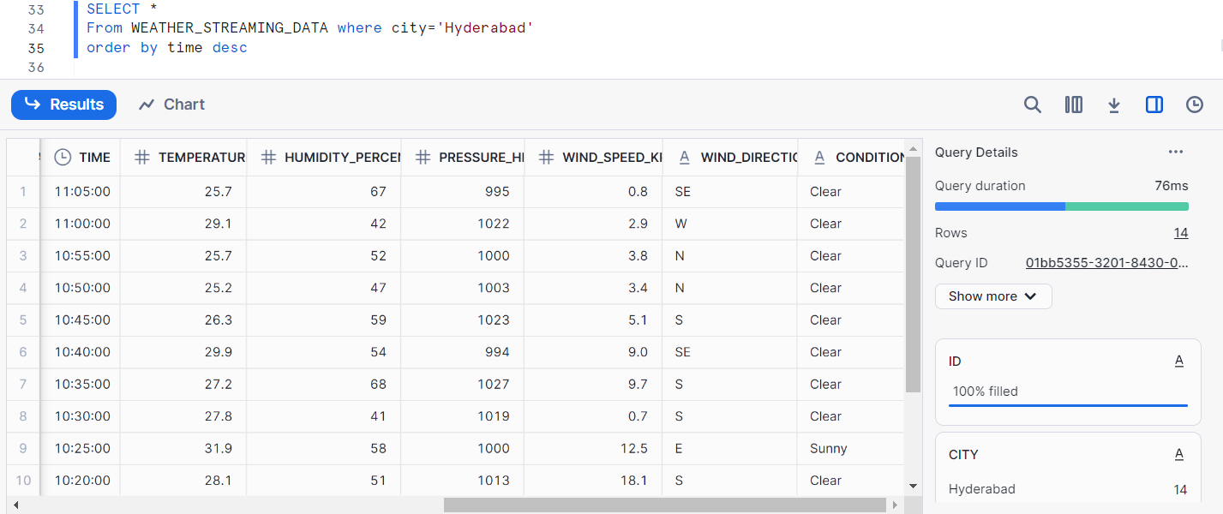
Snowflake Table

Slide 5
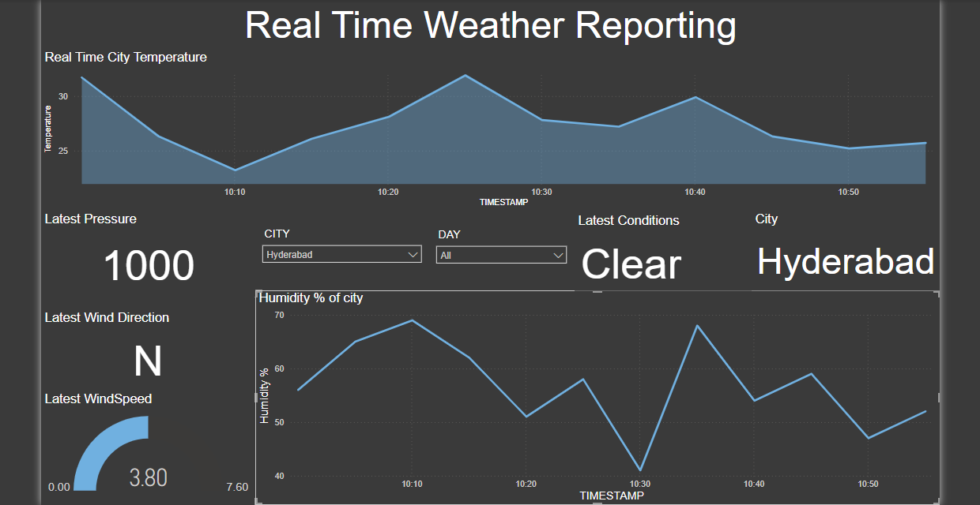
Power BI Dashboard

Slide 6
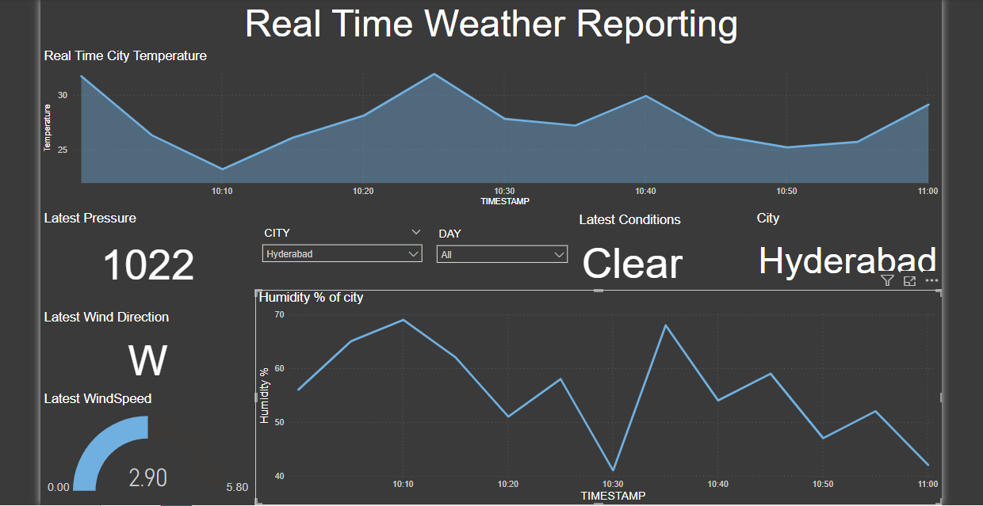
Power BI Dashboard

